Slide 1
DISCIPLINARY PROCESS CHECKLIST

Slide 2
Introduction
The delivery of high quality health service requires all employees to adhere to high standards of work performance, conduct and attendance.
The purpose of this checklist is to support the human resource for health department through the disciplinary process and ensure that it is carried out in a fair and consistent manner throughout the health sector.

Slide 3
Introduction
The checklist will ensure that disciplinary cases are processed with a reporting link to the HR Management & Development Directorate and Regulatory bodies towards enforcement of a professional code of conduct and values in the health sector.

Slide 4
Scope
The disciplinary checklist applies to all health workers employed/engaged by the National and County governments and sets out the process to be followed in the event that health workers are subject to disciplinary action.

Slide 5
Principles of the checklist
Partnership approach: This checklist has been developed in partnership between National and County governments, Public Service Commission, County Public Service Boards, Transition Authority, Regulatory bodies and Development partners.
Prompt handling: Investigation of suspected or alleged breaches of disciplinary standards and any subsequent disciplinary procedures and action will be conducted as promptly as is practicable, consistent with ensuring fairness, consistency and proper adherence to procedural requirements and timescales.

Slide 6
Principles of the checklist
Consistency and equality: This checklist is intended to ensure that the principles of fairness, equity, reasonableness and justice are applied consistently for all health workers in addressing matters which may warrant disciplinary action.
Investigation: No formal disciplinary procedures will be instigated against a health worker for misconduct unless the allegations have been fully investigated and sufficient evidence established to warrant a disciplinary hearing.

Slide 7
Principles of the checklist
Right of Appeal: The health worker will have the right to appeal against any disciplinary action applied to them.

Slide 8
Discipline Process Flow
The process is presented in 6 steps:
Receipt of allegations
Preliminary inquiry
Investigation
Determination
Appeal
Review

Slide 9
1. Receipt of allegation
Complaint on alleged misconduct will be made in writing by the supervisor addressed to the Authorized officer and will be received by the HRM department.
The complaint must be recorded and acknowledged within 7 days.

Slide 10
2. Preliminary inquiry
Supervisor will conduct a preliminary inquiry and compile a report including supporting evidence.
Where there is no evidence the case will be dismissed and the complainant informed in writing.
A show cause letter will be issued to the officer where there is sufficient and specific evidence. Response must be made within 21 days from the date of the letter.

Slide 11
2. Preliminary inquiry
After 21 days the case is submitted to the Departmental CHRMAC to make recommendations to the Authorized Officer.
The decision of the Authorized Officer will be conveyed to the officer.
If the matter warrants further investigation the Authorized Officer will form an adhoc committee to investigate the allegations of misconduct.

Slide 12
3. Investigation
The investigating officer(s) should be senior to the accused and should not have dealt with the case before.
The committee will prepare an investigation report with findings and submit this report to the Authorized Officer.
Where there is need, or on request, the investigating committee shall allow an officer to appear in person or with his representatives to enable him defend himself/herself.

Slide 13
3. Investigation
The investigation report will include:
a)The name of the officer charged;
b)The particulars of the charge as set out in the show cause letter;
c)The reply by the charged officer to the particulars in the charge;
d)The issues for investigation as established by the investigator;
e)The oral and documentary evidence availed on each issue and the names of the witnesses if any;
f)The conclusions or findings on each issue;
g)A statement of opinion by the investigating officer or committee on whether the officer is guilty or innocent as charged as well as any material information aggravating or mitigating the case.

Slide 14
4. Determination
The Authorized Officer will present the report to County HRMAC for deliberation and appropriate recommendation.
The County HRMAC will present their recommendations to the Authorized Officer for decision as the case may be.
The Authorized Officer will then communicate the decision to the employee and inform him on his right to appeal the decision.
The decision will be communicated to the regulatory body where the employee is a member.

Slide 15
5. Appeal
An Officer who is dissatisfied or affected by a decision made by the Authorized Officer at National level may appeal to the PSC against the decision and at County level the Officer may appeal to the CPSB against the decision.
The appeal must be made in writing within 42 days after the date of the decision and should be addressed to the Secretary, PSC/CPSB through the Authorized Officer who shall give comments on the issues raised.

Slide 16
5. Appeal
Any person at county level who is dissatisfied or affected by a decision made by the CPSB may appeal to the Public Service Commission (PSC).
The appeal must be in writing within 90 days after the date of the CPSB decision, but the commission may entertain an appeal later if in the opinion of the Commission, the circumstances warrant it.

Slide 17
6. Review
Any person dissatisfied or affected by a decision made by the Public Service Commission on appeal in a decision made in a disciplinary case may apply for review.
The application for a review must be made in writing within six months from the date of the communication of the decision. The Commission may hear an application for review out of time if the circumstance warrants it.
The PSC will make a final determination and inform the affected person.

Slide 18
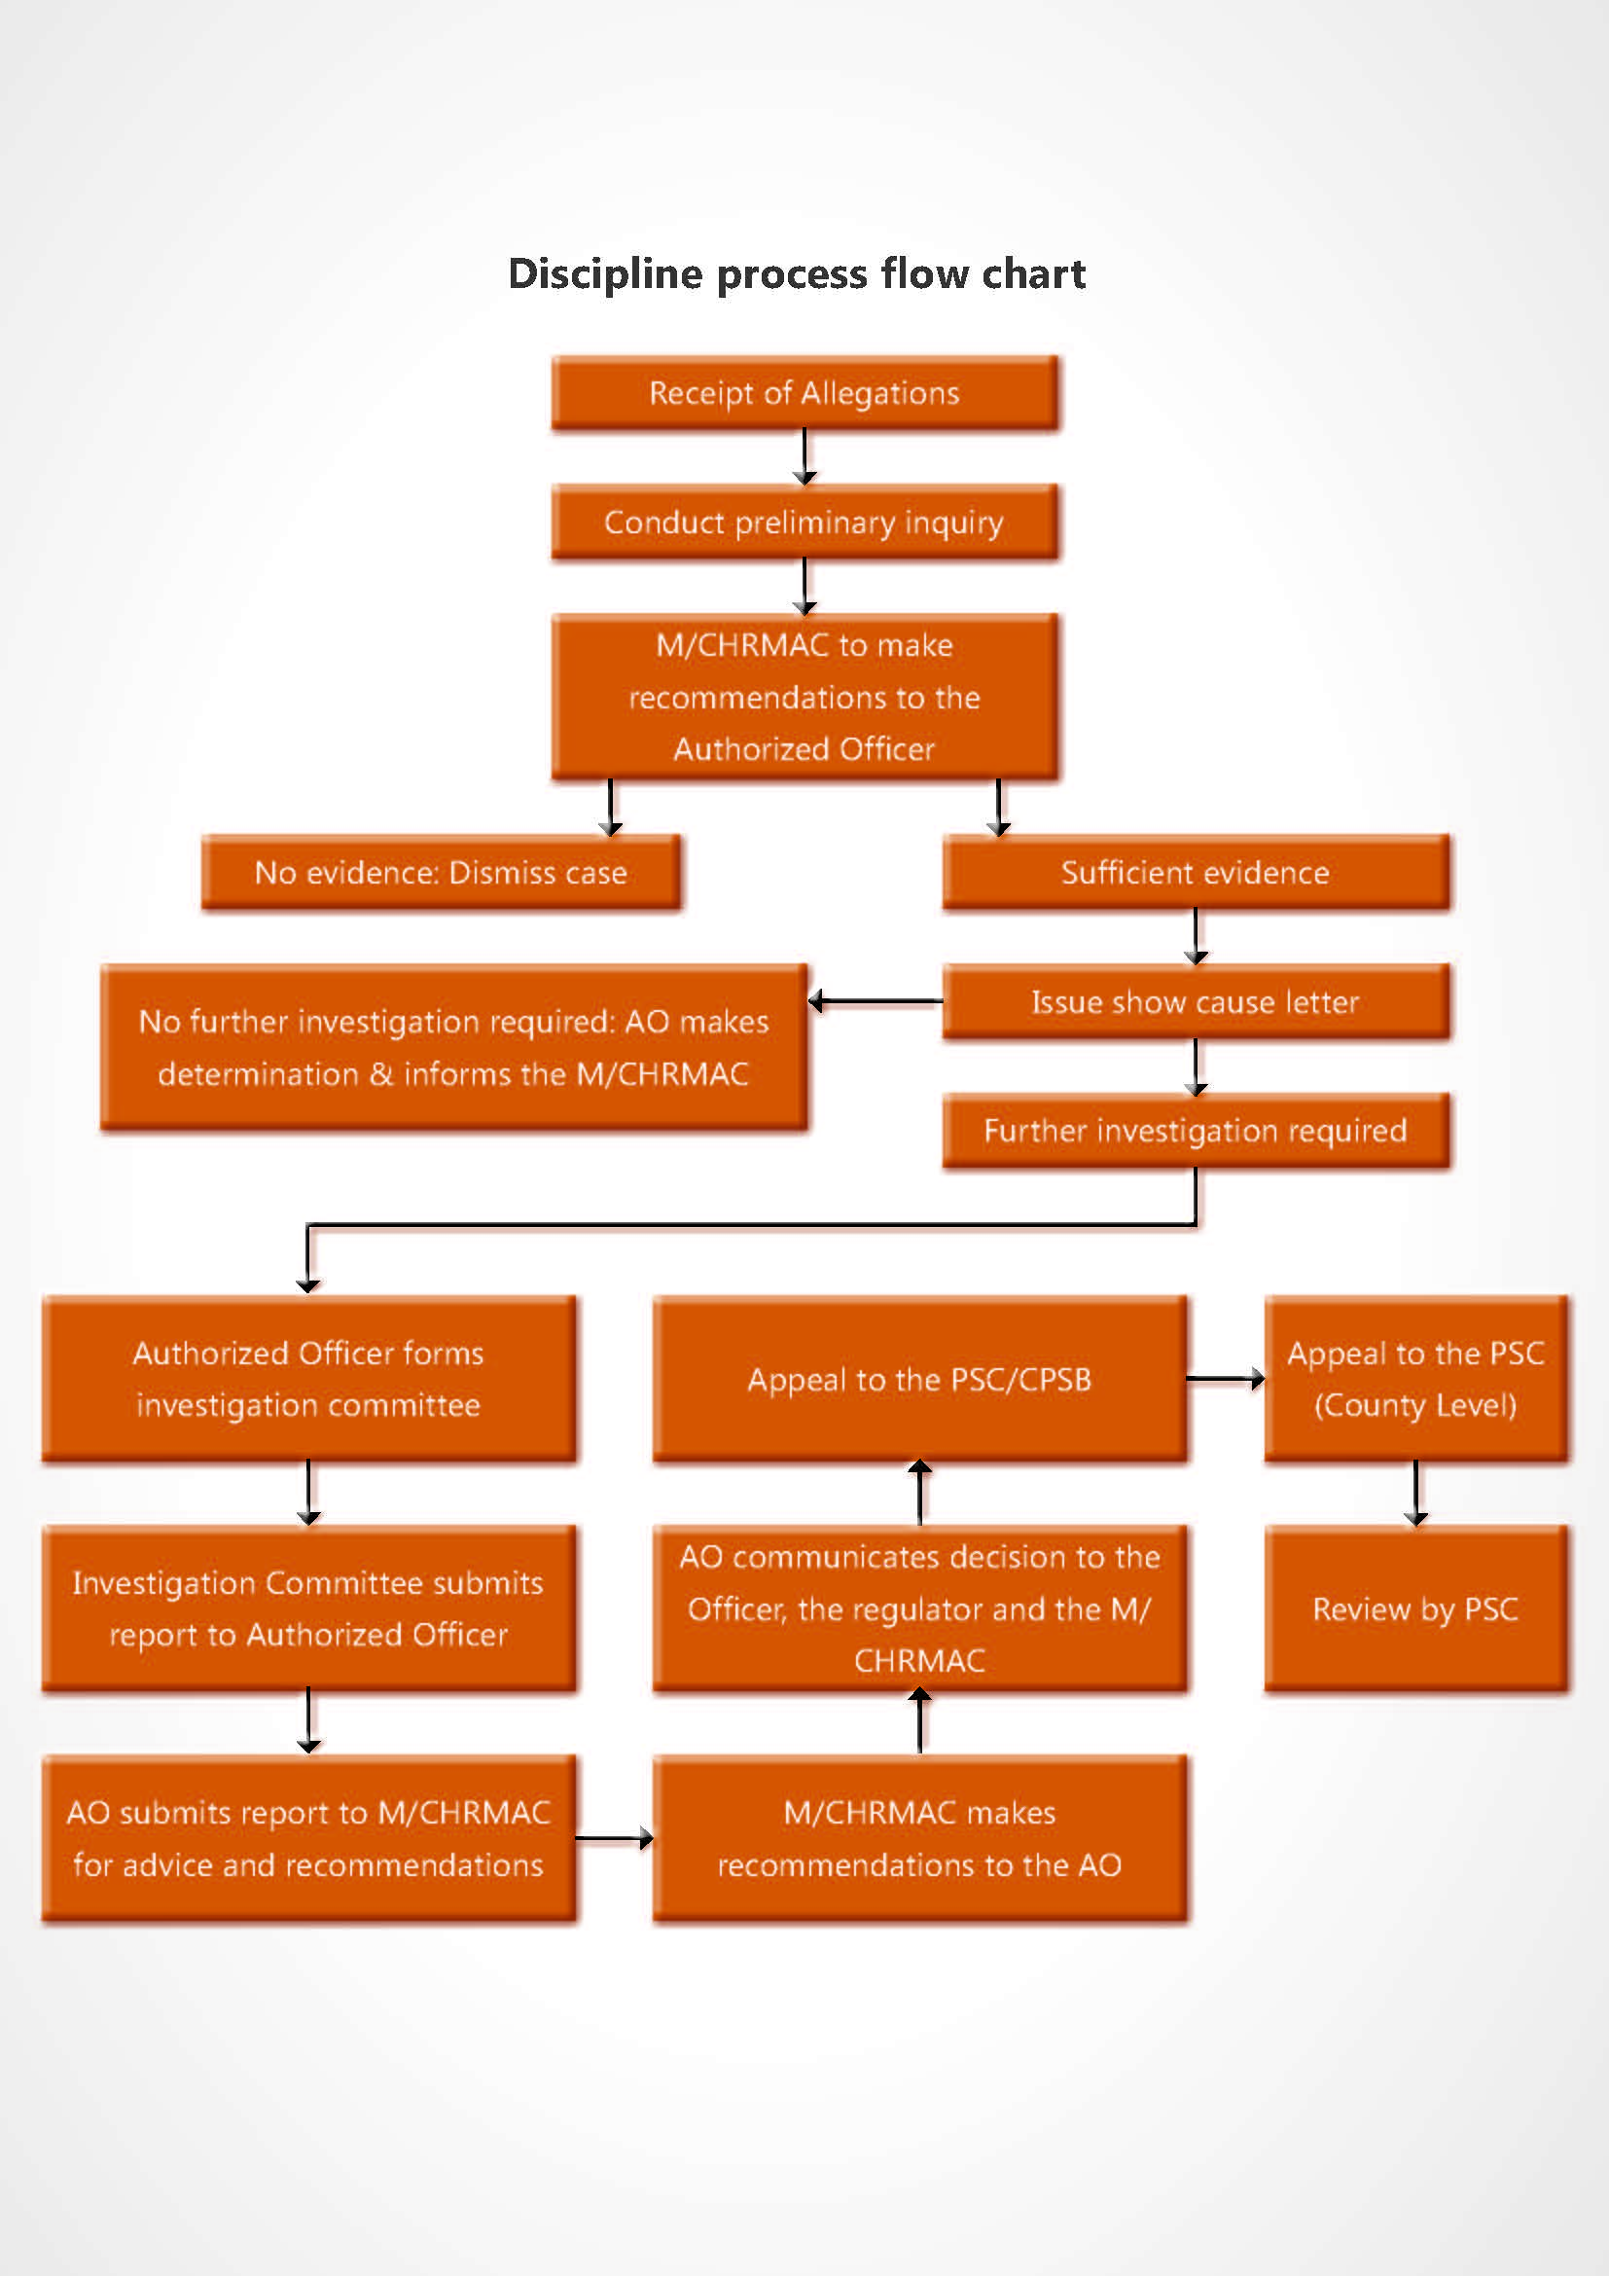

Slide 19
Thank you

